Slide 1
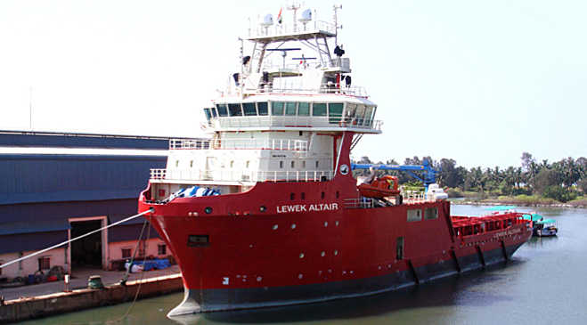
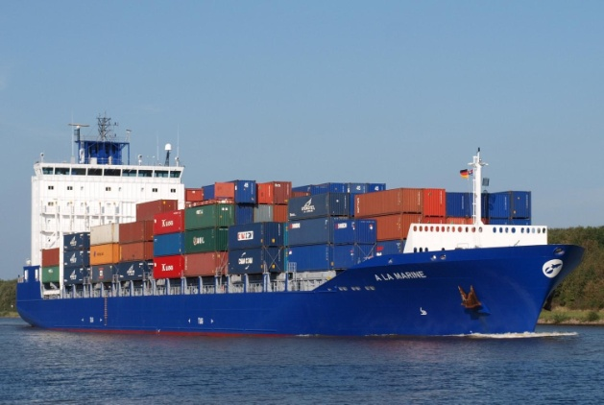
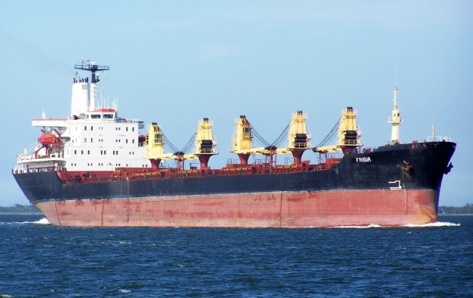
SHIPTECK MARINE SOLUTIONS PVT. LTD.
Ground Floor, Sushila Sadan Building, Behind Sanman Hotel, Vaddem,
Vasco-da-Gama, Goa, 403802.

Slide 2
Our organization
Shipteck Marine Solutions Private Limited firmly believes in "People", "Leadership" and “Technical Excellence" as the foundation of reliable and effective service.
In selection of both sea and shore based staff, Shipteck Marine Solutions Private Limited maintains an industry leading standard of recruitment and training; developing staff in a friendly, inter-active working environment, geared towards continuous improvement. Whilst providing complete crews for ship operators / owners / managers fleet of vessels under our crewing agency.
Most importantly, we're responsible for the safety and health of our people onboard and ashore. Safety always comes first. We take responsibility for the environment and our surroundings because we want to protect our planet for future generations.

Slide 3
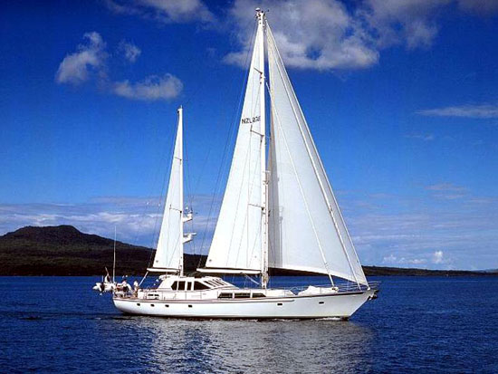
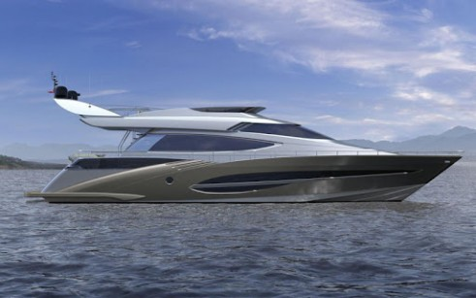
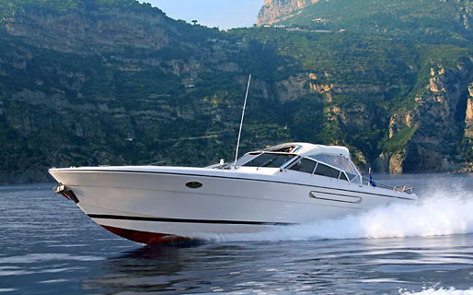
Our organization
Responsibility also means honesty and trustworthiness. We expect all our people to do the right thing and never to accept unethical or questionable business practices. We manage significant values on behalf of our customers.
We take responsibility for the job being done in a professional, cost-effective manner that preserves their assets and reputation. We also guarantee first-class training for our employees.

Slide 4
History
We are pleased to introduce you our company “SHIPTECK MARINE SOLUTIONS PRIVATE LIMITED” duly registered with Directorate General of Shipping having Recruitment and Placement Services License (RPSL-MUM-309). We are certified as ISO 9001 : 2008 Company by IRS & MLC 2006. Professional and ship Management Company having its registered office at heart of Commercial City of Goa
The company has been established with a primary focus to provide Quality Ship Management Services to Ship Owner’s and thereby ensuring smooth and profitable operation of vessels under its management.

Slide 5
VISION & MISSION OF OUR COMPANY
MISSION:
SHIPTECK MARINE provides for sophisticated crew management solution, ensuring
that client care, ethics and professionalism through good management policies, effective
training of crew and the possession of appropriated qualification factors.
Recognizing that quality of crew has a direct bearing on the ship's overall achievement;
the company embarks on an intensive superior search and selection of its officers and
ratings.
VISION:
SHIPTECK MARINE visualizes an emergent manning agency, committed to providing
quality crew compliant to the requirements of international STCW regulations on ship
manning and administration.
This vision established SHIPTECK’S tradition of high quality and efficient operations.
It shaped the company's core purpose and core values.

Slide 6
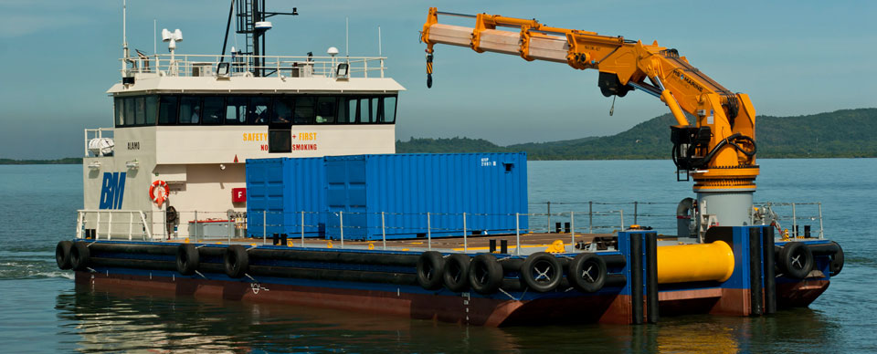
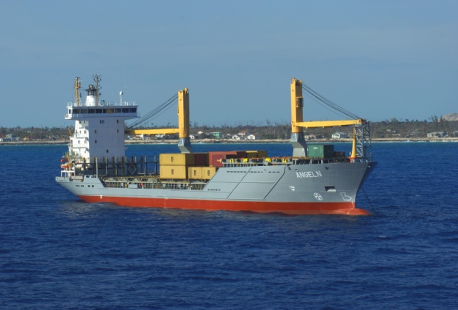
Why Shipteck marine solutions?
"It is our management’s policy and philosophy to be competent and accountable to our clients in all areas of business. We believe in teamwork both within and with the clients to ensure best possible solutions to any problem."

Slide 7
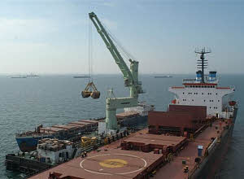
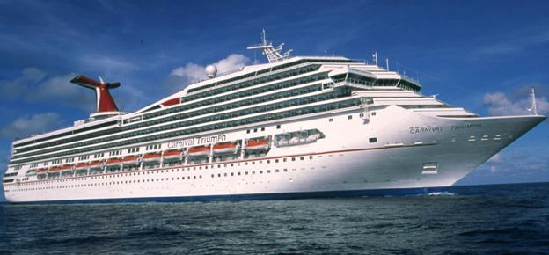
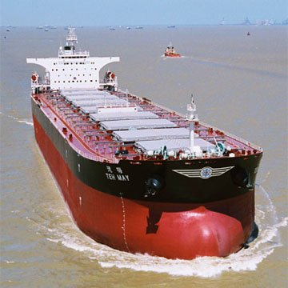
OBJECTIVES
Our objectives are to provide qualitative crew manning services and to supply our clients with highly experienced personnel who are:
“Qualified, trained and certified Manpower as per STCW-95 standouts thereby meeting the requirement of Ship owner
“Medically fit for service.
“Adequately experienced to operate assigned vessels.

Slide 8
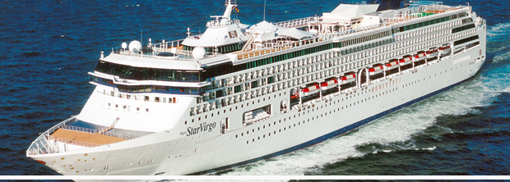
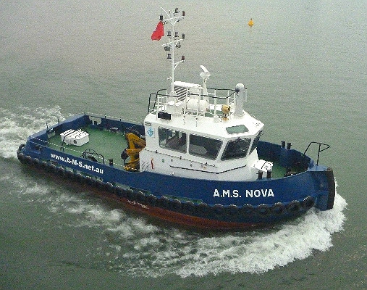
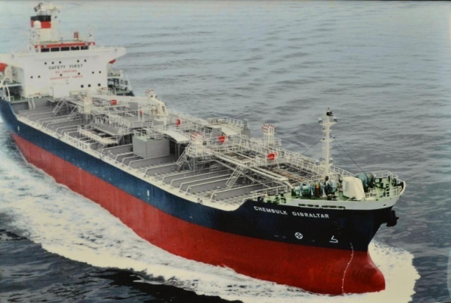
OUR SERVICES
SHIP MANAGEMENT SERVICES
MANNING
TECHNICAL
FABRICATION & SHIP BUILDING
CONSULTANCY
SHIP INSPECTION
SPECIAL PROJECTS

Slide 9
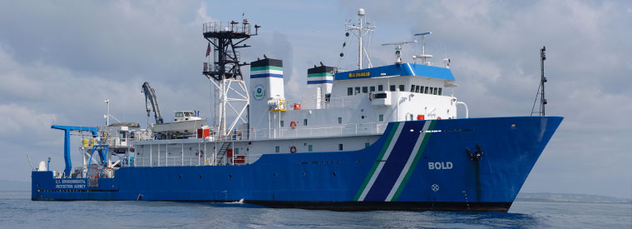
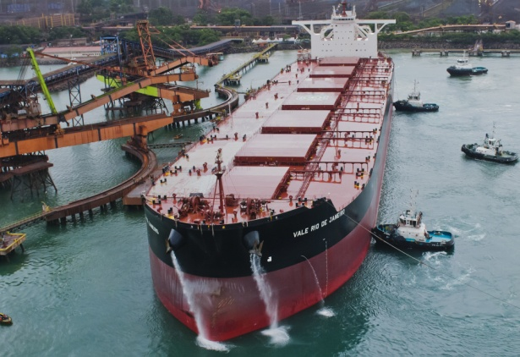
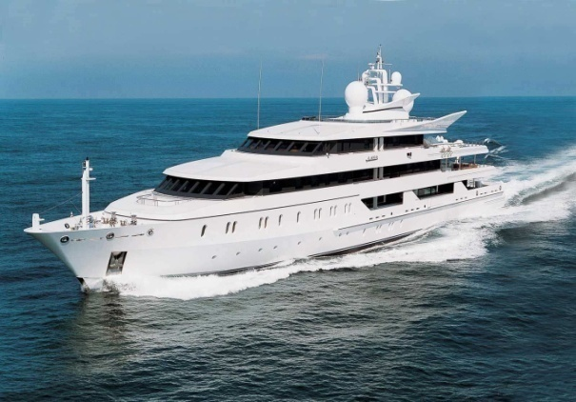
OUR POLICIES IS TO ENSURE
“Safety to the seafarer’s, vessel and the environment
“Effectiveness and excellence of our services.
“Compliance with all applicable National and International standards and guidelines as set by IMO/Shipping authorities" & Cost efficiency

Slide 10
Client List
1. Goa Golf Club Pvt. Ltd. (M.V. JAI SOFIA Passenger Vessel - Technical and Manning)
2. Fabrication of Floating Crane Barges and Tugs - Manning and Technical)
3. IV Passenger Vessel (Manning & Technical)
4. JSW Steel (Salav) Limited (RSV I Manning)
5. Fabrication of HATCH COVERS for barges of JSW Steel
6. Bapu’s Shipping Jamnagar Pvt. Ltd. (Vessel M.T. VAILANKANNI - Manning & Technical)
7. . Navinya Shipping Services Pvt. Ltd. (Mini Bulk Carrier - Technical and Manning)
8. Credence Logistics Ltd. (Barge Manning)

Slide 11
LOOKING FORWARD FOR BUILDING LONG TERM RELATION SHIP WITH YOU….
THANK YOU !!!!
CONTACT US @
Contact No : 0832 – 2500138, +91 9373691744
Email us @ info@shipteck.com , shipteck531@gmail.com

